Slide 1
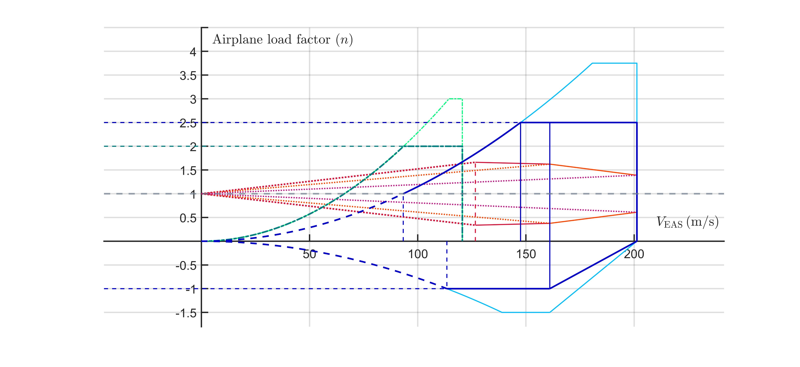





























$$Flaps up$$
$$Structural failure area$$
$$V_{AU}$$
$$V_{DU}$$
$$Maneuver$$
$$envelope$$
$$Flaps down$$
$$Structural$$
$$damage area$$
$$n_{lim}$$
$$Structural$$
$$damage$$
$$area$$
$$V_{A}$$
$$V_{C}$$
$$V_{D}$$
$$V_{F}$$
$$Gust envelope$$
$${n_{lim}}_{manoeuvring}$$
$$V_{B}$$
$$+V_{B} gust−line$$
$$Structural$$
$$failure area$$
$$+V_{C} gust−line$$
$$+V_{D} gust−line$$
$$−V_{D} gust−line$$
$$−V_{C} gust−line$$
$$−V_{B} gust−line$$
$$V_{S1}$$
$${n_{lim}}_{neg}$$
$$W=429900 kg$$
$$h=28000 ft$$
$${V_{S1}}_{neg}$$
$$Structural$$
$$damage area$$
$$Structural failure area$$

Slide 2
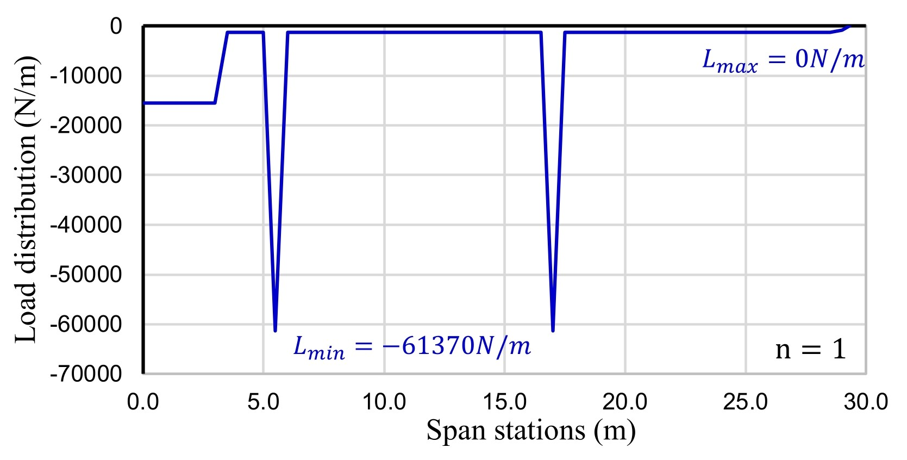
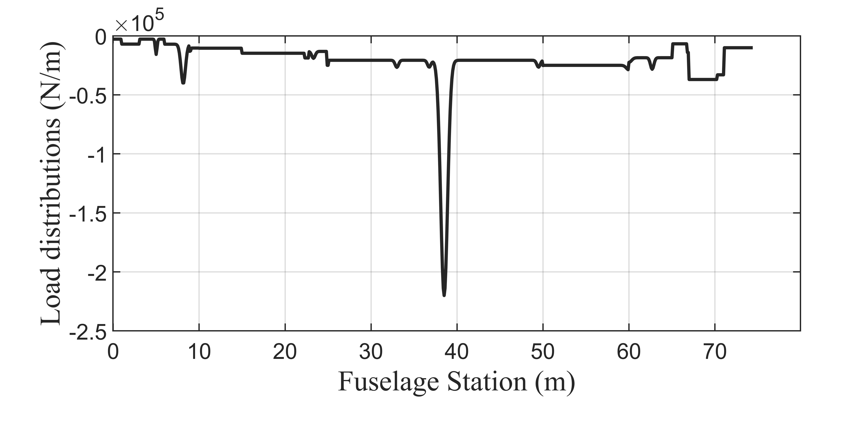



$$L_{max=}=−2811.86N/m$$
$$L_{min=}=−220004N/m$$
$$n=1$$

